Slide 2
Freedom Park School
Principal - Dr. Titania Singh
Assistant Principal – Ms. Amanda Darville
Assistant Principal – Ms. Wendy May

Slide 3
Agenda
Introduction
Communications
Supplies
Launchpad/Classlink/i-Ready lessons
2023-2024 School Year
Message from Guidance Counselor

Slide 4
Teachers
Ms. Mary Alice Cooper
CoopeMa@boe.Richmond.k12.ga.us
Ms. Alexandria Faapue “Ms. F”
FaapuAl@boe.Richmond.k12.ga.us
Ms. Carrie Francis
FrancCa@boe.Richmond.k12.ga.us
Ms. Melissa Lloyd
LloydMe@boe.Richmond.k12.ga.us
Ms. Louanne Dozier
dozielo@boe.richmond.k12.ga.us
Ms. Whitney Johnson-Almand
johnswh@boe.richmond.k12.ga.us

Slide 5
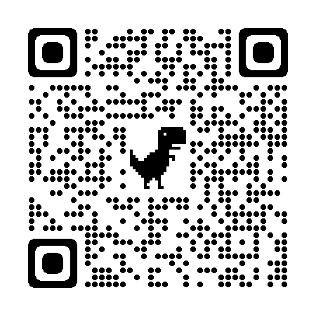
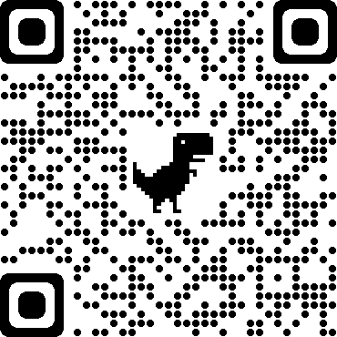
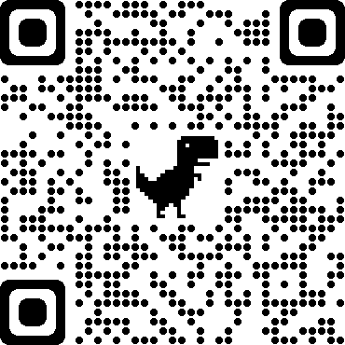
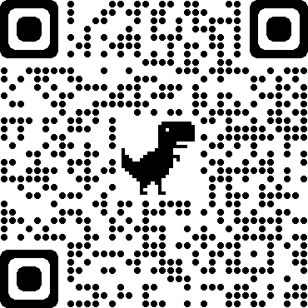
QR Codes For Your Teacher
Ms. Cooper
Ms. Dozier
Ms. Francis
Ms. Faapue
Ms. Lloyd
Ms. Johnson-Alamnd

Slide 6
kindergarten
Supply list
Supply list
GENERAL LEARNING
Plastic Crayon BOX
2 boxes of Crayola crayons
Black Skinny Expo markers
Tri-Write Pencils (Ticonderoga)
Elmer’s Glue Sticks
Large pink erasers
Scissors
1 pair of headphones with name
2 packs of index cards
Socks (erasers for white boards)
Loose Leaf Binder Rings for paper/notecards
WISH LIST ITEMS
Printer Paper
White Cardstock
Construction Paper
Paper Towel Rolls
Zip-Lock Bags (all sizes)
Paper Plates
Large Crayola Paint
CLASSROOM HYGIENE AND SUPPLIES
Plastic water bottle with screw on lid & name
Nap mat
1 change of current season appropriate clothes
Disinfectant wipes
Microban Spray: Sanitizing Spray, Multipurpose Spray, & Bathroom Spray
White t-shirt (tie-dye for field trips)
© Crayons to Confidence 2020

Slide 7
Communications
All kindergarten teachers can be reached directly through Class Dojo.
Information will be sent home on how to sign up.
Seesaw will be used if we are ever instructed to learn from home.
Parents can check student work and grades on here as well.
A great way to learn how to navigate Seesaw is this to click the links below.
https://www.youtube.com/watch?v=nv87eyvNxY0 (Child Account Example)
https://www.youtube.com/watch?v=jotQ5PQQuVw (Parent Account Example)

Slide 8
Launch Pad
You can access LaunchPad through the desktop application (if you are on the district's network) or at https://launchpad.classlink.com/rcboe if you are at home.
Launch Pad is were you will be able to access all applications (I-ready and Seesaw) that we will be using this year for Face 2 Face and Online Instruction.

Slide 9
i-Ready
Richmond County uses iReady as a diagnostic assessment and instructional tool.
Richmond County asks that every student complete 45 minutes per week on ELA and Math i-Ready lessons.
Use the weekends to play catch up if needed or for fun!

Slide 10
2023-2024 School Year
START TIME
Students may enter the gym from the carline drop off area from 6:50 am - 7:25 am. The school day starts at 7:25 am.
SCHOOL NUTRITION
Breakfast begins at 7:15 when kindergarten enters their room
Breakfast is free for all students
Lunch begins at 10:15 am
See nutrition LINK for free/discounted lunch applications
English Lunch Application
Spanish Lunch Application
Healthy snacks are allowed at the end of the day
END TIME
Dismissal begins at 2:00 pm
Students must be picked up by 2:30 pm

Slide 11
Attendance Policy
Attendance Policy
Students are expected to be in school all day unless they are ill. Georgia State law only recognizes absences due to illness, religious holidays, medical or legal appointments, and funerals in the family. Parents have the right to present reasons they believe are justifiable to the Principal for consideration of other absences.
All absences require a written note from parents/guardians stating the reason for the absence. Emailed notes will not be accepted. A note without a reason and date of absence is unexcused. The note must include the student's full name, reason for absence, date(s) of absence, and parent/guardian signature.
In order to comply with district regulations and state law, when a student has 10 unexcused absences in one month or ten unexcused absences in one year, Richmond County administrators will petition the Juvenile Court System to seek mandatory attendance by a student. An unexcused absence is defined as any unauthorized absence from school. Examples include, but are not limited to:
1. Hair appointments
2. Oversleeping
3. Shopping
4. Missing the bus
5. Concerts
6. Babysitting
7. Failure to obtain private transportation to school
8. Mechanical problem
9. Failure to obtain leave of Absence request for absences

Slide 12
Tardy Policy
Students are not allowed on campus prior to 6:50 a.m. Any student reporting to the classroom after 7:25 a.m. is tardy. A parent must sign in tardy students.
The accumulation of unexcused tardies may warrant disciplinary action and/or referral to
Department of Family and Children Services.
Leaving school for unauthorized purposes before the end of the instructional day will be counted as
a tardy. Parents should not pick their children up before the end of the school day except where
there is a legitimate emergency. Lawful excuses for tardiness are cited in the RCSS Code of Student
Conduct and Discipline.
For the safety of our students during dismissal transition, we will not allow building entry starting at 1:55 pm until 2:10pm.

Slide 13
Title 1
Freedom Park School is a Title I school. This means we are provided financial assistance through the Every Student Succeeds Act, Part A. Its overall purpose is to ensure that all students have a fair and equal opportunity to obtain a high-quality education and reach, at a minimum, proficiency on state assessments (i.e. GA Milestones, End-of-Course, etc.), as well as involve parents in their child's education.
There will be an upcoming Title I Annual Parent Meeting which will outline parent involvement opportunities - you will be sent meeting information via FPS's ClassDojo account later in the school year.
If you have any questions, please contact the FPS Title I Parent Facilitator:

Slide 14
Bullying: No Bullying. It’s the Law
Bullying behavior is defined as any pattern of written or verbal expression or any physical act or gesture that is intended to ridicule, humiliate, intimidate, or cause measurable physical or emotional distress upon one or more students:
A student shall not do, attempt, or threaten to bully any person, including students and employees:
a) In the school
b) On school grounds
c) In school vehicles (including school buses)
d) At school bus stops
e) Or at school activities or sanctioned events
A third instance of bullying in a school year would require that the student be assigned to an alternative educational setting. However, the principal or other appropriate designee may recommend the Alternative Center or suspension, in her discretion prior to the third offense.
*FOR PRE-K – 5 REFER TO RULES 23 AND 24 (RCBOE CODE OF CONDUCT)
*FOR 6 -12 DISCIPLINE OPTIONS, REFER TO RULES 23, 24, &amp;27 (RCBOE CODE OF CONDUCT)
Code of Discipline for Freedom Park School
Students are expected to display admirable Character Traits at all times. They are representative of their family, school and community. At FPS we have always maintained a respectful environment for staff and students.
Bullying
No Bullying.
It’s the law!

Slide 15
Message from Guidance Counselor

Slide 17
i-Ready
Richmond County uses iReady as a diagnostic assessment and instructional tool.
Richmond County asks that every student complete 45 minutes per week on ELA and Math i-Ready lessons.
Use the weekends to play catch up if needed or for fun!

Slide 18
Thank you so much for
attending our
2023-2024
Open House!
Questions?
Please e-mail your teacher!

